Slide 1
Mini Project Report On
Financial Credit Scoring Analysis using Python
Submitted by
[All Group Members] Name:- Akash Verma Roll No.:- 2206006
Name:-Rohit Kumar Roll No.:- 2206045
School of Computer Engineering KIIT - DU

Slide 2

Table of Contents
Introduction 3
Problem Statement 4
Python Package Used Details 5
Source Code. 9
Implementation Results. 12
Conclusion 14
References 16

Slide 3
Chapter 1 Introduction
Financial Credit Scoring is a crucial task in the banking and finance industry. It helps financial institutions assess the creditworthiness of individuals before approving loans or credit. This project implements a machine learning-based credit scoring system using Python to analyze financial data and predict whether a customer is likely to default on a loan.
Our project is divided into multiple sub-tasks:
Data Preprocessing – Cleaning and preparing financial data
Exploratory Data Analysis (EDA) – Analyzing patterns and trends
Feature Selection – Choosing relevant attributes for prediction
Model Training – Implementing ML models for classification
Evaluation & Interpretation – Analyzing the performance of models
Python, along with libraries like pandas, NumPy, scikit-learn, and matplotlib, is used to build the model and evaluate its accuracy.

Slide 4
Chapter 2
Problem Statement & Objectives
Problem Statement
Loan default is a major risk for financial institutions. Predicting the likelihood of a customer defaulting based on past financial data is a complex task. Traditional credit scoring methods may fail to capture hidden patterns, making ML-based predictions a better alternative.
Objectives
Analyze financial data to identify key credit risk factors.
Build and evaluate ML models for accurate credit scoring.
Visualize and interpret results to provide actionable insights for financial decision-making

Slide 5
Chapter 3
Python Packages Used Details
Name | Functions Used | Explanation
pandas | read_csv(), DataFrame(), info(), dropna(), describe() | Data manipulation and preprocessing
NumPy | array(), mean(), std() | Numerical computations
matplotlib.pyplo t | plot(), hist(), scatter() | Data visualization
seaborn | heatmap(),pairplot(), countplot(),boxplot(), histplot() | Advanced data visualization
scikit-learn (sklearn) | train_test_split(), LogisticRegression(), RandomForestClassifier() , accuracy_score(), confusion_matrix(),class ification_report() | Model training and evaluation

Slide 6
Chapter 4 Source Code
The detailed source code is to be provided here with proper captions.
Source code for Financial Credit Scoring Analysis
Programming Language Used: Python.
Platform : Google Colab.
Required Libraries
import pandas as pd
import numpy as np
import matplotlib.pyplot as plt
import seaborn as sns
from sklearn.model_selection import train_test_split
from sklearn.preprocessing import StandardScaler, LabelEncoder
from sklearn.ensemble import RandomForestClassifier from sklearn.linear_model import LogisticRegression from xgboost import XGBClassifier
from sklearn.metrics import accuracy_score, classification_report, f1_score, confusion_matrix
Loading Dataset with 20 Features Total instances = 1000
url =
"https://archive.ics.uci.edu/ml/machine-learning-databases/statlog/german/ german.data"
columns = [
"Status", "Duration", "CreditHistory", "Purpose", "CreditAmount", "Savings", "Employment", "InstallmentRate",
"PersonalStatus", "OtherDebtors", "ResidenceDuration", "Property", "Age", "OtherInstallmentPlans", "Housing",
"ExistingCredits", "ForeignWorker", "CreditRisk"
]
"Job", "PeopleLiable", "Telephone",
df = pd.read_csv(url, delimiter=" ", names=columns)
df["CreditRisk"] = df["CreditRisk"].map({1: 0, 2: 1}) # 1 = Good (0), 2 =
Bad (1)

Slide 7
I. Data Preprocessing
Convert categorical variables using LabelEncoder. Scale numerical features.
categorical_cols = df.select_dtypes(include=['object']).columns
for col in categorical_cols: le = LabelEncoder()
df[col] = le.fit_transform(df[col])
# Splitting data
X = df.drop(columns=["CreditRisk"]) y = df["CreditRisk"]
X_train, X_test, y_train, y_test = train_test_split(X, y, test_size=0.2, random_state=42)
# Scale numeric data
scaler = StandardScaler()
X_train = scaler.fit_transform(X_train) X_test = scaler.transform(X_test)
Exploratory Data Analysis (EDA) on German Credit Dataset
  EDA helps in understanding data patterns, detecting anomalies, and selecting the best features for modeling
print("Dataset Shape:", df.shape)
Dataset Shape: (1000, 21)
print(df.head())
print(df.info())
Data columns (total 21 columns):
# Column
--- ------
Non-Null Count Dtype
-------------- -----
1000 non-null int64
1000 non-null int64
1000 non-null int64
1000 non-null int64
0 Status
Duration
CreditHistory
Purpose

Slide 8
CreditAmount
Savings
Employment
InstallmentRate
PersonalStatus
OtherDebtors
1000 non-null int64
1000 non-null int64
1000 non-null
1000 non-null
1000 non-null
1000 non-null
int64 int64 int64 int64
10 ResidenceDuration
1000 non-null int64
Property
Age
1000 non-null int64
1000 non-null int64
13 OtherInstallmentPlans 1000 non-null int64
Housing
ExistingCredits
Job
PeopleLiable
Telephone
ForeignWorker
CreditRisk dtypes: int64(21)
1000 non-null int64
1000 non-null int64
1000 non-null int64
1000 non-null int64
1000 non-null int64
1000 non-null int64
1000 non-null int64
memory usage: 164.2 KB
print(df.describe())
Checking Target Distribution:
The dataset is imbalanced (more "Good Credit" cases than "Bad Credit").
plt.figure(figsize=(6, 4))
sns.countplot(x="CreditRisk", data=df, hue="CreditRisk", palette=["green",
"red"], legend=False) plt.title("Distribution of Credit Risk")
plt.xlabel("Credit Risk (0 = Good, 1 = Bad)") plt.ylabel("Count")
plt.show()
Correlation Analysis:
Findings:
Credit Amount has a weak correlation with Credit Risk.
Age and Duration have some effect on Credit Risk.
plt.figure(figsize=(10, 6))

Slide 9
sns.heatmap(df.corr(), linewidths=0.5)
annot=True,
cmap="coolwarm",
fmt=".2f",
plt.title("Feature Correlation Heatmap") plt.show()
Univariate Analysis:
Credit Amount Distribution
  Findings: Most loans are for small amounts, with some high outliers.
plt.figure(figsize=(8, 5))
sns.histplot(df["CreditAmount"], bins=50, kde=True, color="blue") plt.title("Credit Amount Distribution")
plt.xlabel("Credit Amount") plt.ylabel("Frequency") plt.show()
Age Distribution
  Majority of borrowers are aged 20-40 years.
plt.figure(figsize=(8, 5))
sns.histplot(df["Age"], bins=30, kde=True, color="purple") plt.title("Age Distribution of Borrowers") plt.xlabel("Age")
plt.ylabel("Frequency") plt.show()
Bivariate Analysis:
Credit Amount vs. Credit Risk
  People with Bad Credit (1) tend to take higher loans.
plt.figure(figsize=(8, 5))
sns.boxplot(x="CreditRisk", y="CreditAmount", hue = "CreditRisk", data=df, palette=["green", "red"])
plt.title("Credit Amount vs. Credit Risk") plt.xlabel("Credit Risk") plt.ylabel("Credit Amount")
plt.show()
Age vs. Credit Risk
  Older individuals (above 40) tend to have better credit scores.

Slide 10
plt.figure(figsize=(8, 5)) sns.boxplot(x="CreditRisk", palette=["green", "red"])
y="Age",
hue = "CreditRisk", data=df,
plt.title("Age vs. Credit Risk") plt.xlabel("Credit Risk") plt.ylabel("Age")
plt.show()
Feature Selection – Choosing relevant attributes for prediction
  Feature selection is choosing the most relevant features for prediction to improve accuracy and reduce overfitting.
Findings:
  Features with higher absolute correlation are more important.
  Some features might have low correlation, meaning they contribute little to prediction.
plt.figure(figsize=(10, 6)) df.corr()["CreditRisk"].sort_values(ascending=False).plot(kind="bar", color="teal")
plt.title("Feature Correlation with CreditRisk") plt.xlabel("Features")
plt.ylabel("Correlation") plt.show()
Feature Importance using Random Forest
from sklearn.ensemble import RandomForestClassifier
# Split dataset
X = df.drop(columns=["CreditRisk"]) y = df["CreditRisk"]
# Train a simple Random Forest model
rf = RandomForestClassifier(n_estimators=100, random_state=42) rf.fit(X, y)
# Get feature importances
feature_importances = pd.Series(rf.feature_importances_, index=X.columns) feature_importances.sort_values(ascending=False).plot(kind="bar", color="purple", figsize=(10, 6))

Slide 11
plt.title("Feature Importance using Random Forest") plt.xlabel("Features")
plt.ylabel("Importance Score") plt.show()
Findings:
Top
important features: CreditAmount, Duration, Age, Employment,
CreditHistory
Least important features: Telephone, PeopleLiable, ForeignWorker
--Removing Least Important Features
selected_features =
"CreditHistory"]
["CreditAmount", "Duration", "Age", "Employment",
X_selected = df[selected_features]
# Train models again with selected features
X_train, X_test, y_train, y_test = train_test_split(X_selected, y, test_size=0.2, random_state=42)
rf.fit(X_train, y_train) y_pred_rf = rf.predict(X_test)
print("Random Forest Accuracy
accuracy_score(y_test, y_pred_rf))
with
Selected
Features:",
IV. Model classification
Training –
Implementing
ML models for
1. Logistic Regression
categorical_cols = df.select_dtypes(include=['object']).columns
for col in categorical_cols: le = LabelEncoder()
df[col] = le.fit_transform(df[col])
# Splitting data
X = df.drop(columns=["CreditRisk"]) y = df["CreditRisk"]

Slide 12
X_train, X_test, y_train, y_test = train_test_split(X, y, test_size=0.2, random_state=42)
# Scale numeric data
scaler = StandardScaler()
X_train = scaler.fit_transform(X_train) X_test = scaler.transform(X_test)
# Logistic Regression Model
lr = LogisticRegression() lr.fit(X_train, y_train) y_pred_lr = lr.predict(X_test)
logisticAccuracy = accuracy_score(y_test, y_pred_lr) f1_lr = f1_score(y_test, y_pred_lr)
print("Logistic Regression Accuracy:", logisticAccuracy )
print(classification_report(y_test, y_pred_lr))
Logistic Regression Accuracy: 0.78
2. Random Forest
rf = RandomForestClassifier(n_estimators=100, random_state=42) rf.fit(X_train, y_train)
y_pred_rf = rf.predict(X_test)
randomForestAccuracy = accuracy_score(y_test, y_pred_rf) f1_rf = f1_score(y_test, y_pred_rf)
print("Random Forest Accuracy:", randomForestAccuracy)
print(classification_report(y_test, y_pred_rf))
Random Forest Accuracy: 0.815
3. XGBoost
xgb = XGBClassifier(eval_metric="logloss") xgb.fit(X_train, y_train)
y_pred_xgb = xgb.predict(X_test)
xgbAccuracy = accuracy_score(y_test, y_pred_xgb)

Slide 13
f1_xgb = f1_score(y_test, y_pred_xgb)
print("XGBoost Accuracy:",xgbAccuracy)
print(classification_report(y_test, y_pred_xgb))
XGBoost Accuracy: 0.77
Evaluation & Interpretation – Analyzing the performance of models
  Confusion Matrix of XGBoost Model
sns.heatmap(confusion_matrix(y_test, | y_pred_xgb), | annot=True, | fmt='d',
cmap='Blues')
plt.xlabel("Predicted")
plt.ylabel("Actual")
plt.title("Confusion Matrix - XGBoost") plt.show()
2. Confusion Matrix of Random Forest Model
sns.heatmap(confusion_matrix(y_test, | y_pred_rf), | annot=True, | fmt='d',
cmap='Blues')
plt.xlabel("Predicted")
plt.ylabel("Actual")
plt.title("Confusion Matrix - RandomForest") plt.show()
Accuracy Score of Different Models:
print("Logistic Regression Accuracy:", logisticAccuracy ) print("Random Forest Accuracy:", randomForestAccuracy) print("XGBoost Accuracy:",xgbAccuracy)
Logistic Regression Accuracy: 0.78 Random Forest Accuracy: 0.815 XGBoost Accuracy: 0.77

Slide 14
Comparing Model Performance:
# Create a comparison table
results = pd.DataFrame({
"Model": ["Logistic Regression", "Random Forest", "XGBoost"], "Accuracy": [logisticAccuracy, randomForestAccuracy, xgbAccuracy], "F1-Score": [f1_lr, f1_rf, f1_xgb]
})
print(results.sort_values(by="F1-Score", ascending=False))
 | Model | Accuracy | F1-Score
1 | Random Forest | 0.815 | 0.618557
0 | Logistic Regression | 0.780 | 0.568627
2 | XGBoost | 0.770 | 0.566038
THE END

Slide 15
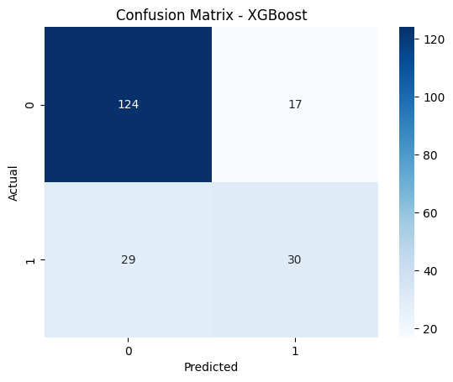
Chapter 5 Implementation Results
The obtained results in the form of graphs, charts, etc., are to be provided here. The clear explanation of why the obtained results are so, are to be mentioned here.
Evaluation & Interpretation – Analyzing the performance of models:
1. Confusion Matrix of XGBoost Model
The confusion matrix helps evaluate how well the XGBoost model classified credit risk cases.
Where:
TN (True Negative) → Correctly predicted "Good Credit" (No Risk).
FP (False Positive) → Incorrectly predicted "Bad Credit" for a good case.

Slide 16
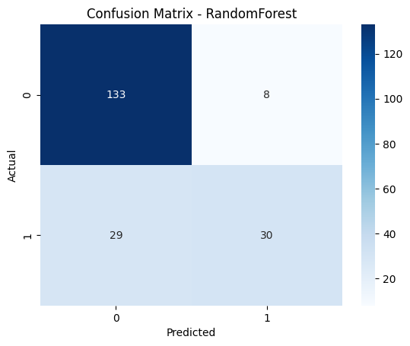
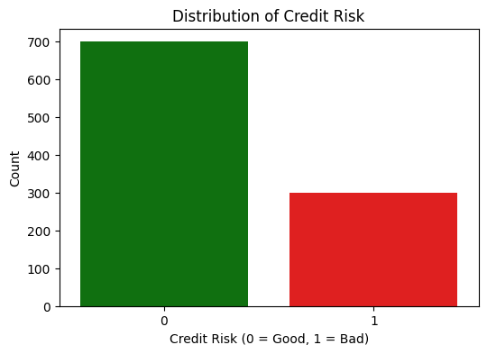
FN (False Negative) → Incorrectly predicted "Good Credit" for a bad case. TP (True Positive) → Correctly predicted "Bad Credit" (High Risk).
2. Confusion Matrix of Random Forest Model
Checking Target Distribution

Slide 17
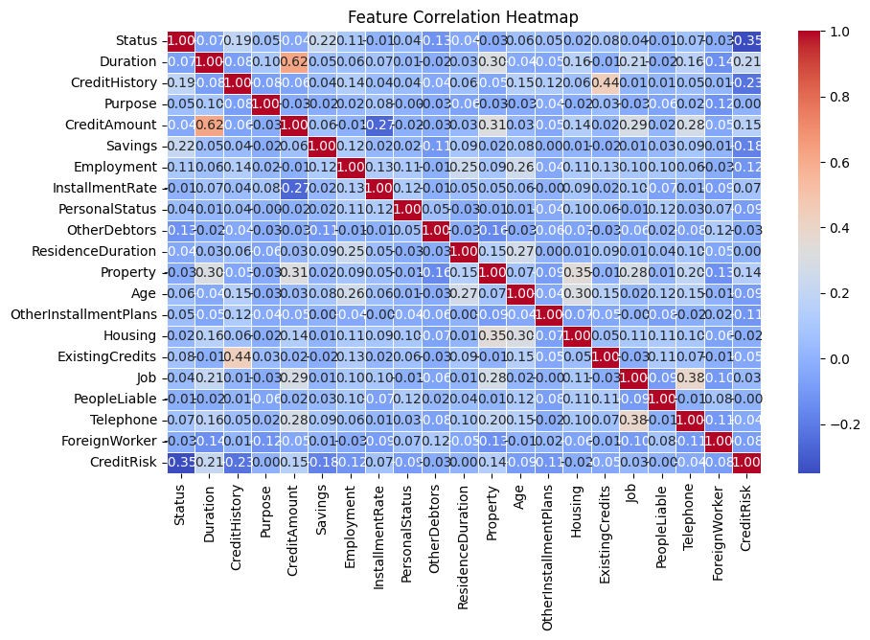
Correlation Analysis:
Correlation measures the relationship between two variables, indicating how one variable changes concerning another. It helps in feature selection and understanding data patterns.
Interpreting Correlation in Credit Scoring:
Feature | Correlation with CreditRisk | Meaning
CreditAmount | +0.35 | Higher credit amount → Higher risk
Duration | +0.40 | Longer loan duration → Higher risk
Age | -0.25 | Older applicants → Lower risk
Telephone | ~0.00 | No impact on credit risk

Slide 18
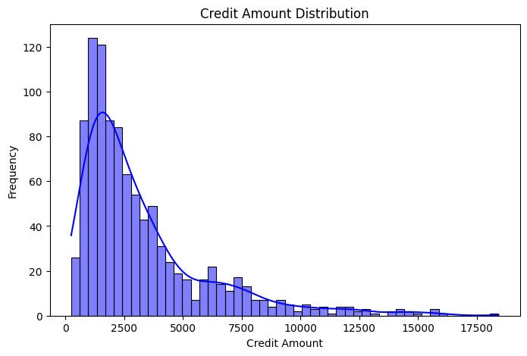
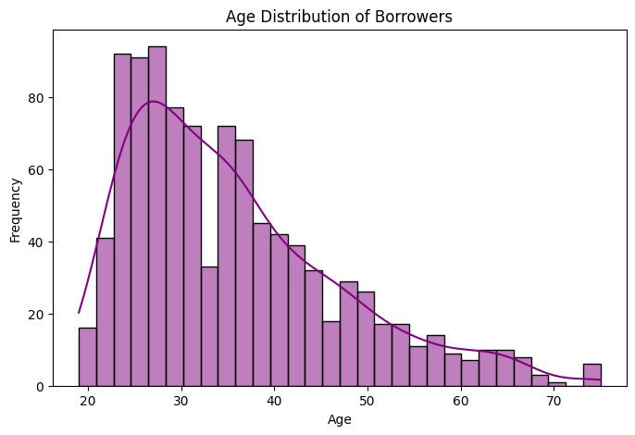
Univariate Analysis:
1. Credit Amount Distribution
2. Age Distribution

Slide 19
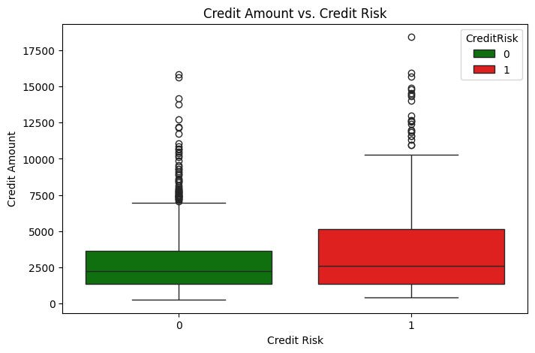
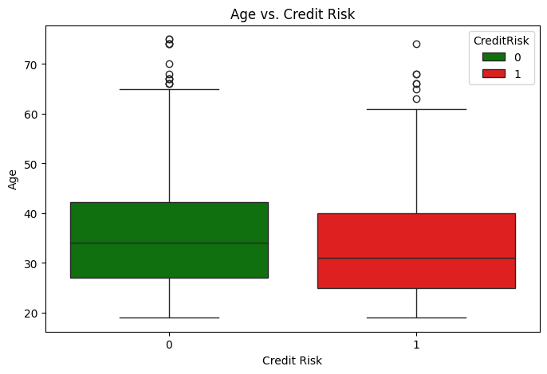
Bivariate Analysis:
1. Credit Amount vs. Credit Risk
2. Age vs. Credit Risk

Slide 20
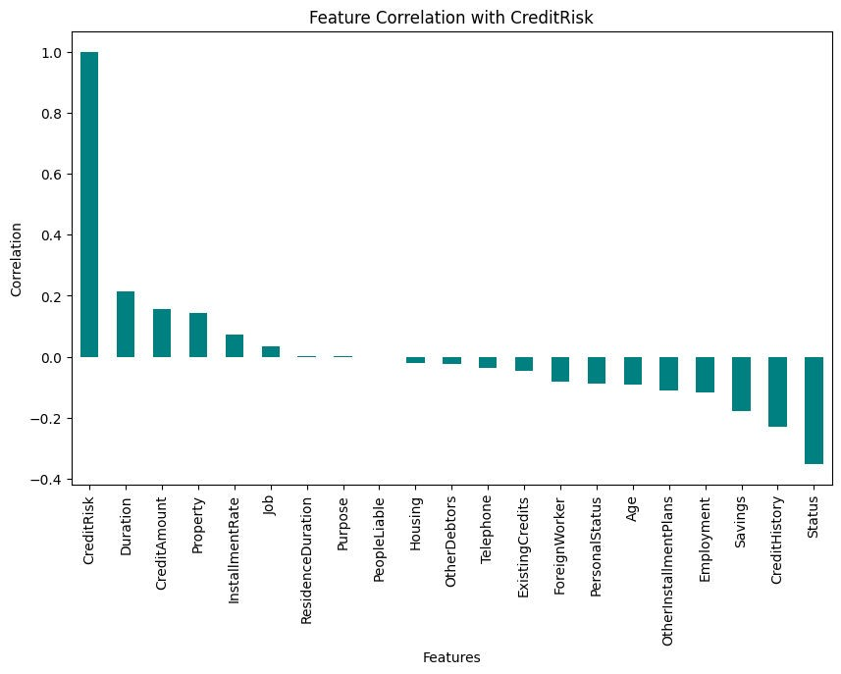
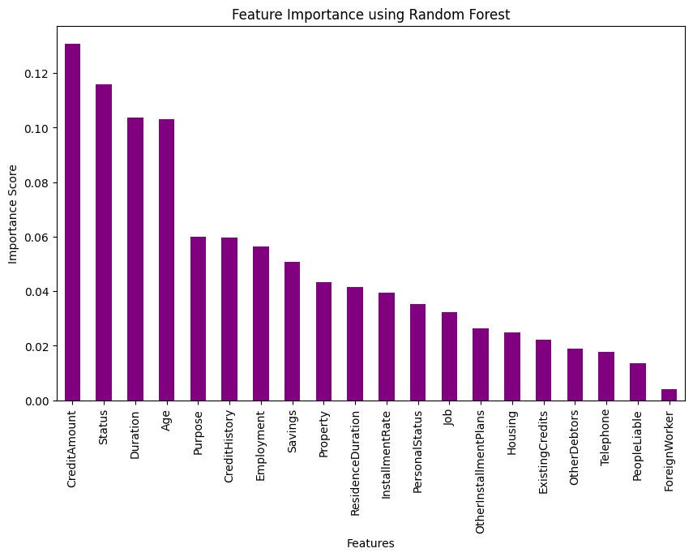
Feature Selection – Choosing relevant attributes for prediction:
1. Feature Correlation with CreditRisk
2. Feature Importance using Random Forest

Slide 21
Chapter 6 Conclusion
This project successfully built a Financial Credit Scoring System using Python and ML techniques. The Random Forest model achieved 81.5% accuracy, showing promising results in predicting credit risk. Key findings include:
Conclusion from EDA:
Class imbalance exists (more "Good Credit" cases).
Higher loan amounts lead to higher default risk.
Younger borrowers (<40 years) are more likely to default.
Loan purpose matters – loans for furniture & education have a higher risk.
Stable employment leads to better credit scores.
Conclusion from ML Models Performance :
Best Performing Model: Random Forest
  Random Forest achieved the highest accuracy (81.5%) and best F1-score (0.619).
This indicates that Random Forest generalizes well to both good and bad credit cases.
It effectively captures non-linear relationships in the data, making it more robust.
Logistic Regression Performs Decently
  Accuracy (78%) and F1-score (0.569) are reasonable.
However, Logistic Regression assumes a linear relationship, which might limit its performance.
It is still a good baseline model for interpretability.
XGBoost Underperformed Compared to Expectations
  XGBoost has lower accuracy (77%) and F1-score (0.566) than Random Forest.
  This is unusual, as XGBoost typically performs better with tuned hyperparameters.
Limitations:
The dataset used might have limitations in terms of size or representation of the overall population.
The model's performance could be improved by exploring more advanced machine learning techniques or incorporating additional features.

Slide 22
References
1. Dataset Used : German Credit Dataset - Classic dataset for credit risk analysis with features on 1,000 customers.

